Slide 1

Connect 4 The Game
Atharv Joshi 19104036
Shridhar Joshi 19104034
Siddhesh Puranik 19104014
Akshada Warik 19104042
Project Guide
Ms. Rujata Chaudhari
Notes:
1

Slide 2
Contents
Introduction
Objectives
Scope
Features / Functionality
Project Outcomes
Technology Stack
Notes:
2

Slide 3
1. Introduction
Problem Identified :
Connect 4 is a physical game and cannot be played long distance
Solution Proposed :
Making the game in virtual format with the help of Python language
Notes:
3

Slide 4
2. Objectives
To make the game virtual for up to 4 players.
To be able to store the score of the winner.
To be able to choose the grid size.
To make the game GUI more attractive than the physical game.
Notes:
4

Slide 5
3. Scope
Can be played by players above age of 6.
Can be useful to everyone as it has a lot of strategy used.
Can be played by groups of up to 4 players.
Notes:
5

Slide 6
4. Feature /Functionality
Feature 1 :Number of players
This game has to be played by minimum 2 players and maximum
4 players.
Feature 2 :Win situation
The player who can connect four balls in a line wins. The connection can be vertical, horizontal and even diagonal.
Feature 3 :High score and score count
The winning players name will be noted and will be added to the tally.
Notes:
6

Slide 7
4. Feature /Functionality (contd.)
4. Feature 4: Menu driven
• The game is menu driven as in it gives you prompts to choose your options and what you want to do in the game.
5. Feature 5: Grid size
• The grid size of the game is changeable; the player is given a choice at the beginning of the game to choose the size of the grid on which the game is to be played on.
6. Feature 6: Quick gameplay
• The gameplay takes less time as each game can not exceed 10 to 12 minutes per game.

Slide 8
5. Outcome of Project
This project will provide a fun time for the players
e.g.
User Can choose their colour
User can look who has the highest win count
Users can sharpen their skills in mind games and strategies and make and develop interest in more strategy oriented games like chess.
Notes:
8

Slide 9
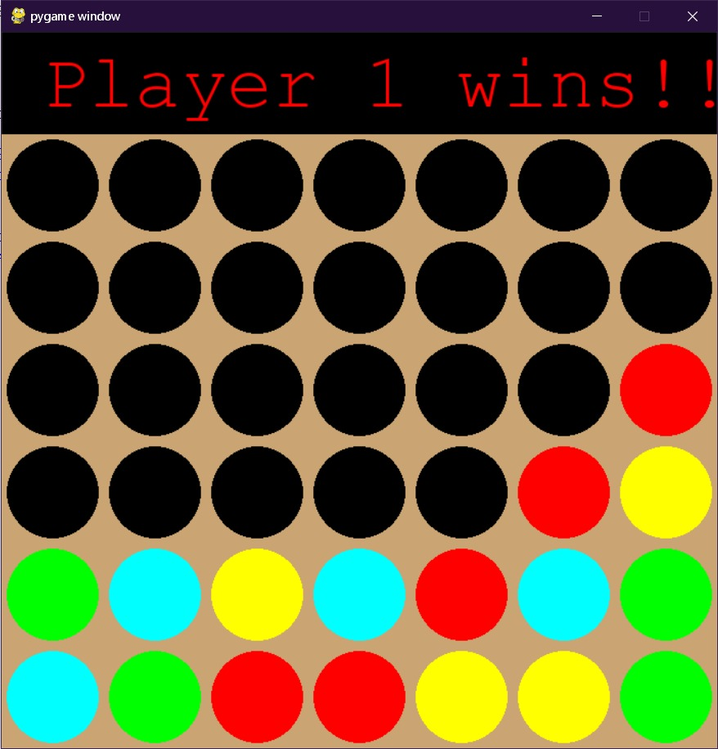
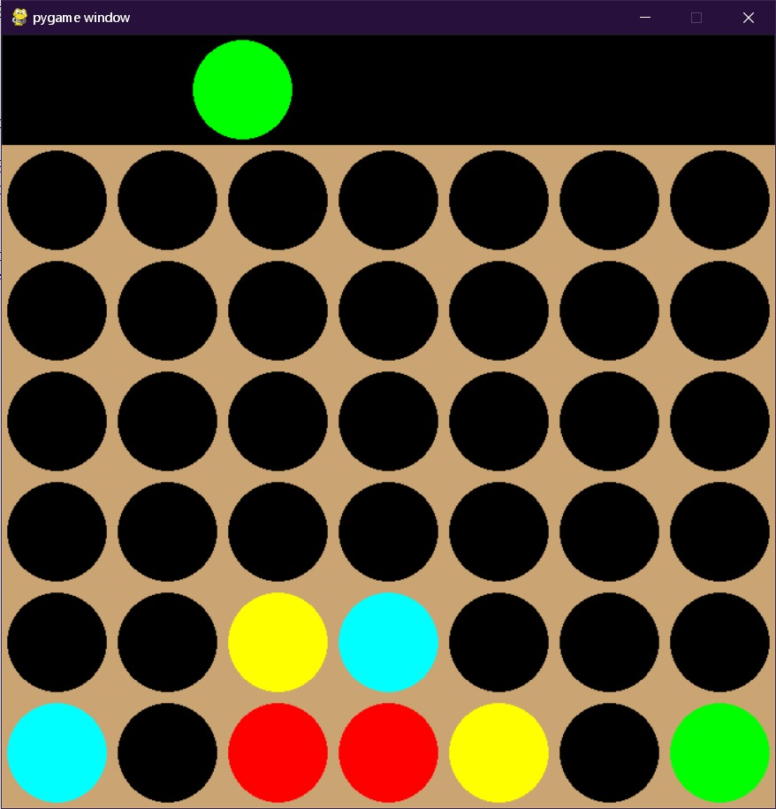
Round Win Condition Successful User Interface

Slide 10
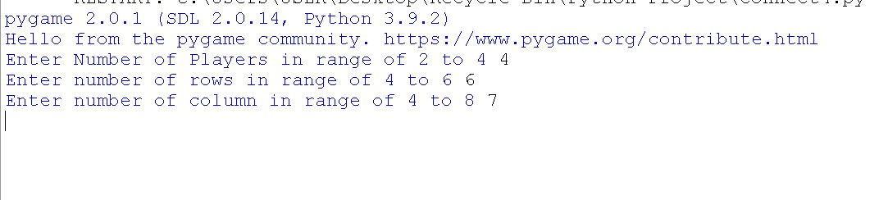
Command Line Execution

Slide 11
6. Technology Stack
-Python is used to make the game and its GUI with needed algorithms. Libraries like pygame and NumPy are used.
-MySQL is used as a database service to store and use player’s data.
Notes:
11

Slide 12
Thank You...!!
Notes:
12

